Slide 1
Presented by:
Prediction of Customer Subscription using Bank Direct Telemarketing Data in Apache Spark
Data Management and Big Data - ALY 6110
CRN 82268
Avinash Sunil Tripathi (tripathi.av@northeastern.edu)
Dishant Rajesh Modi (modi.di@northeastern.edu)
Karan Kaushal Daiya (daiya.k@northeastern.edu)
Rohith Mallula (mallula.r@northeastern.edu)
Vasu Rakesh Ambasana (ambasana.v@northeastern.edu)

Slide 2
Content
Summary
Content
Preface on ML
Supervised and Unsupervised
Why Apache Spark?
Understanding Dataset
EDA
Model building and Prediction: Train-Test sets, Regression, Decision tree, Model evaluation
Comments
Conclusion
References
Q&A

Slide 3
Summary
Telemarketing advertising campaigns are a billion-dollar effort and one of the central uses of the machine learning model. The project is related to the direct marketing campaigns of a banking institution. The marketing campaigns were based on phone calls.
The dataset contains around 1.29 million rows and total of 21 features and is assessed in Apache Spark which will work as high-performance general-purpose computing engine and it works by distributing its workload across several nodes in a cluster, making it a case of Big Data. Often, more than one contact to the same client was required, in order to assess if the product (bank term deposit) would be ('yes') or not ('no') subscribed.
In this project, we predicted Customer Response to Bank Direct Telemarketing Campaign Project in Apache Spark (Machine Learning) using Decision Tree Model and Logistic Regression.

Slide 4
Machine learning and its types
Machine learning is an application of artificial intelligence (AI) that provides systems the ability to automatically learn and improve from experience without being explicitly programmed.
Supervised machine learning algorithms can apply what has been learned in the past to new data using labeled examples to predict future events.
In contrast, unsupervised machine learning algorithms are used when the information used to train is neither classified nor labeled.
There is also Semi supervised and Reinforcement machine learning algorithm but, for the scope of this project, we are focusing on supervised machine learning algorithms.

Slide 5
Why Apache spark?
Spark executes much faster by caching data in memory across multiple parallel operations, whereas MapReduce involves more reading and writing from disk.
It Also supports a rich set of high-level tools such as Spark SQL for SQL and structured data processing, MLlib for machine learning, GraphX for graph processing and spark streaming.
Spark is especially useful for parallel processing of distributed data with iterative algorithms.
The databricks notebook is provided as a service with deployment of apache spark, you can access the same using your web browser by creating a notebook wherein you can write your own code.
Next we will see, why we used Scala and in Spark instead of Python or any other ML language.

Slide 6
Scala Vs Python
PYTHON | SCALA
Python is easy to learn and use. | Scala is less difficult to learn than Python.
Extra work is created for the interpreter at the runtime in Python. | No extra work created in Scala and thus it is faster than Python.
The data types are decided by it during runtime automatically. | This is not the case in Scala which is why while dealing with large data, Scala should be considered instead of Python
Python is used for small-scale projects. | Scala is used for large-scale projects.
Python doesn’t provide scalable feature support. | Scala provides scalable feature support.

Slide 7
Dataset Overview
Dataset: We have taken dataset from kaggle which consists of 1.29 million records and 21 features
Objective: We will try to predict customer response to the banking telemarketing campaign based on the Customer details features. We will be using ML models like decision tree and logistic regression to test the accuracy of our model.
Target variable: Y - Customer Response (yes/no)
Platform: Databricks (Apache spark)
Languages: SQL (data exploration) and SCALA(model building)

Slide 8
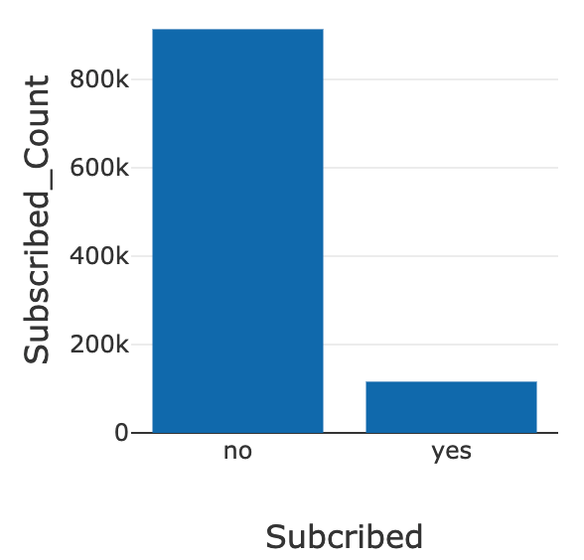
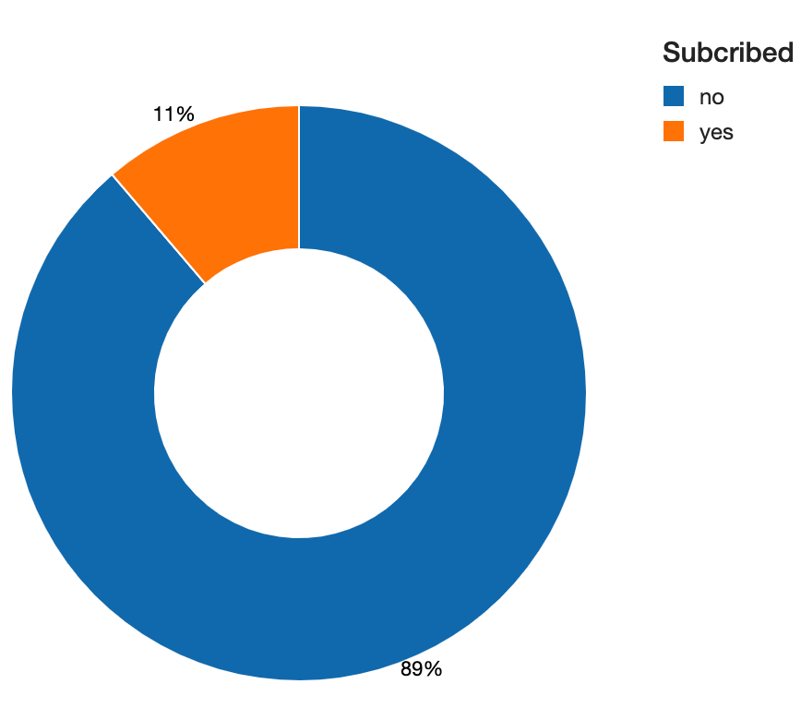
Exploratory Data Analysis
1. Distribution of target variable:
In the current dataset we have more than 950K(89%) NOs and 116k yes (11%).
We can say that only 1 out of 10 people are saying yes.

Slide 9
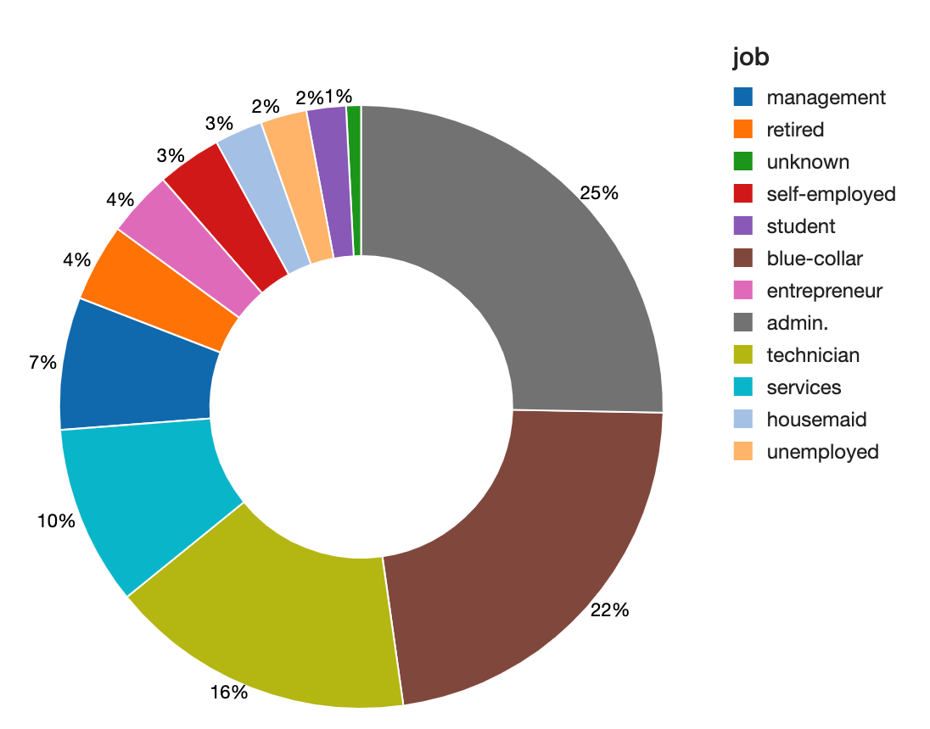
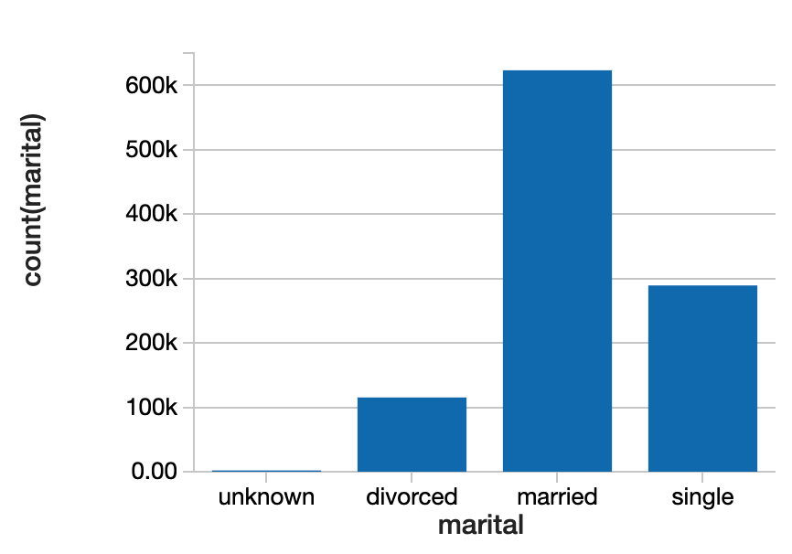
Exploratory Data Analysis
2. Job Distribution
Mostly the people interviewed were consisted of admins, blue collar or technician.
3. Marital Status distribution
More than 620k people were married and rest were either unmarried or divorced.

Slide 10
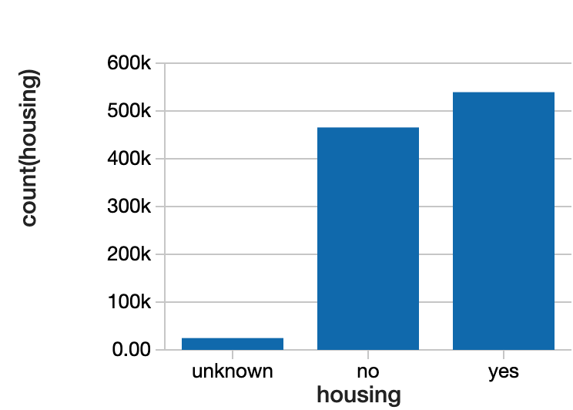
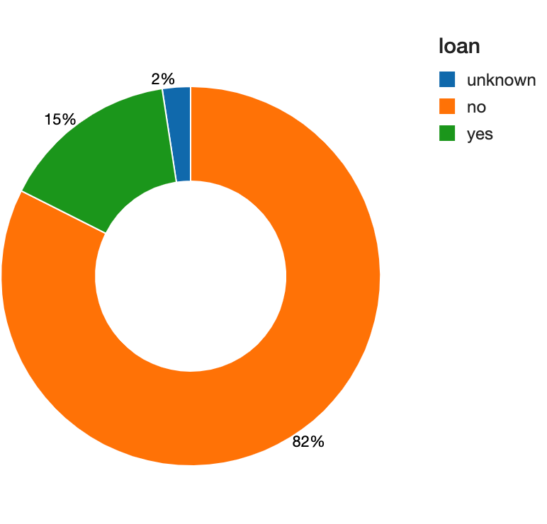
Exploratory Data Analysis
4. Having house loan?
Mostly the people interviewed were consisted of admins, blue collar or technician.
5. Having personal loan?
More than 620k people were married and rest were either unmarried or divorced.

Slide 11
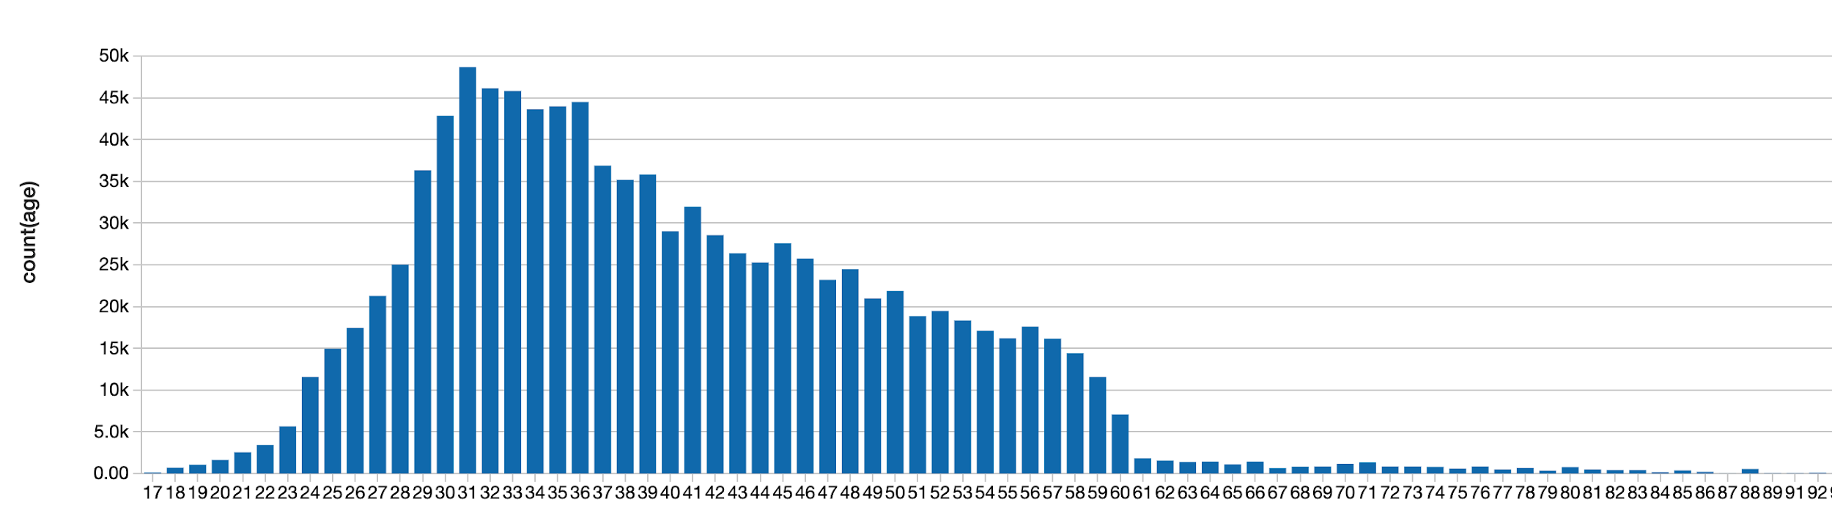
EDA 6. Age distribution:
Graph depicts that the analysis were targeted towards the people ranging between the age group of 20-50

Slide 12
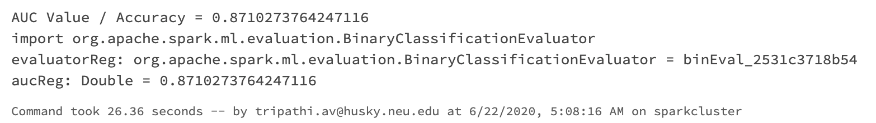
Model Building and Prediction
Split the data: In this project, we will use 70% of the data for training, and reserve 30% for testing.
Train regression model
Transform the testing model
Test the model for prediction
Evaluation score of logistic regression model

Slide 13
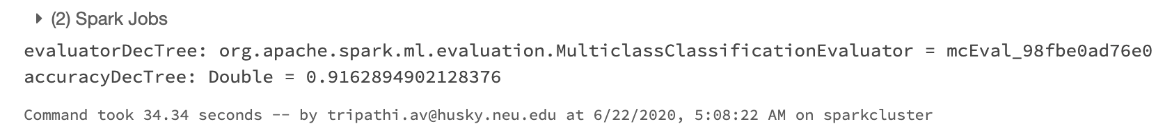
Model Building and Prediction
As we saw, in the previous slide, through logistic regression model we got the accuracy of 87.1%.
We will now check the performance of Decision tree over the same dataset:
Although the process of decision trees evaluation took longer, but we obtained the accuracy of 91.62%. This shows that our model did significantly well on the testing set. We formed tree with depth 5 and total no. of nodes as 39.

Slide 14
Additional Comments
spark.mllib comes with a number of machine learning algorithms that can be used to learn from and make predictions on data. When these algorithms are applied to build machine learning models, there is a need to evaluate the performance of the model on some criteria, which depends on the application and its requirements. spark.mllib also provides a suite of metrics for the purpose of evaluating the performance of machine learning models.
The only difficulty faced was during the creation of pipeline for the data preprocessing. We have used string indexer and vector assembler for preprocessing:
A StringIndexer estimator that converts string values to indexes for categorical features A VectorAssembler that combines categorical features into a single vector

Slide 15
Conclusion
This model is simple and easy to implement.
The bank marketing manager can identify the potential client by using the Decision Tree model if the client’s information like education, duration of the call, number of contacts performed during this campaign, Personal loan, previous outcomes, housing loan, etc is made available.
This will assist the Bank while making critical decisions with regards to minimizing the cost to the bank by avoiding to call customers who are unlikely to subscribe to their packages.
We used Scala because it has reactive cores and a list of asynchronous libraries, testing is much better in scala because it is a statically typed language, the data types are decided by it during runtime in python and on other side, this is not the case in Scala that is why while dealing with large data process. All in all, Scala should be considered instead of Python.

Slide 16
References
MLlib: Main Guide - Spark 3.0.0 Documentation. Spark.apache.org. (2020). Retrieved 20 June 2020, from https://spark.apache.org/docs/latest/ml-guide.html.
Introduction to DataFrames - Scala — Databricks Documentation. Docs.databricks.com. (2020). Retrieved 20 June 2020, from https://docs.databricks.com/spark/latest/dataframes-datasets/introduction-to-dataframes-scala.html
Apache Spark - Quick Guide - Tutorialspoint. Tutorialspoint.com. (2020). Retrieved 20 June 2020, from https://www.tutorialspoint.com/apache_spark/apache_spark_quick_guide.htm.
Valot, M., & Jorand, N. Scala programming projects (pp. 45-54).

Slide 17
Thank you.
Any Questions?

